Slide 1

Introduction to Database Systems
DBS211
Test 2 Review

Slide 2
Conceptual Database Modeling
Data Modeling – the process of following a series of steps to conceptually design a database schema and developing a graphical representation of the database design
Data modelling is a first step in the process of database design
The aim is to describe:
The data in the database
The relationships between the data
The constraints on the data
In the second step, the data items, relationships, and constraints are all expressed using concepts provided in the high-level model
Designing the database is the third step is database implementation and operators/user interface build

Slide 3
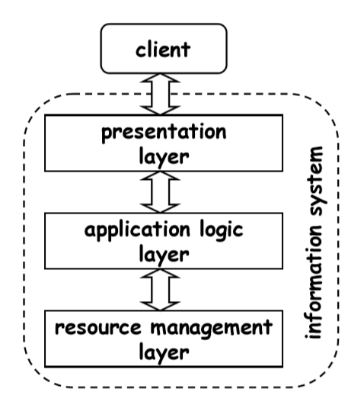
Application Layers - Introduction
Layered Architecture – a structural layout separating the system into different levels that are in charge of carrying out particular tasks
There are 3 layers:
Presentation layer/User Interface/View Layer
Business Logic/Application Logic
Resources Management/Data Access/Model Layer
Each layer interacts with the layers above and below
The creation of complex applications depends greatly on software architecture

Slide 4
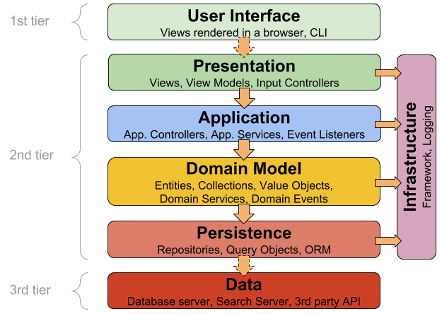
Application Layers - Introduction

Slide 5
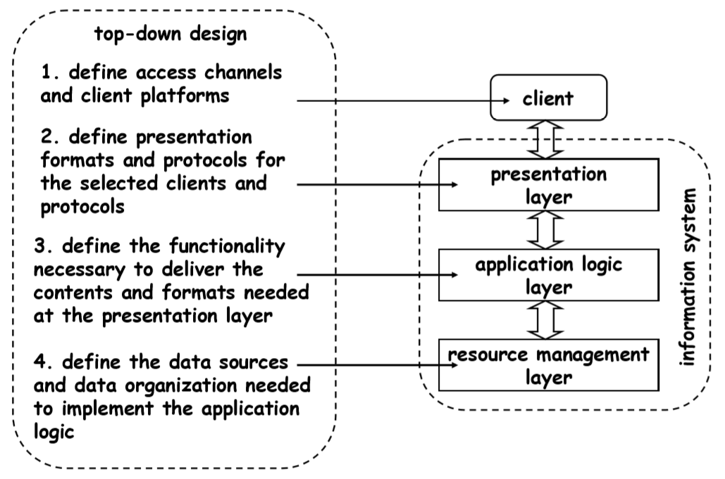
Top-Down Design

Slide 6
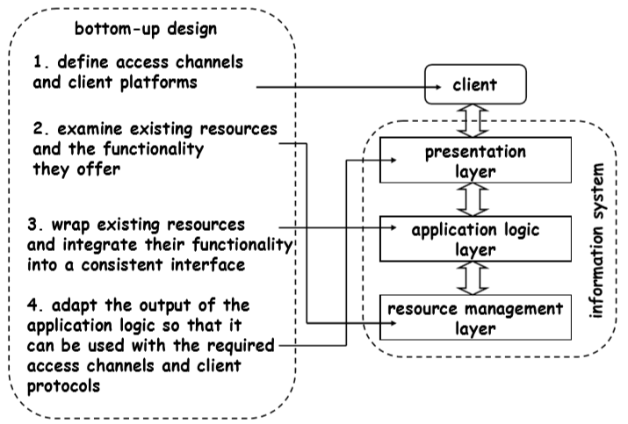
Bottom-Up Design

Slide 7
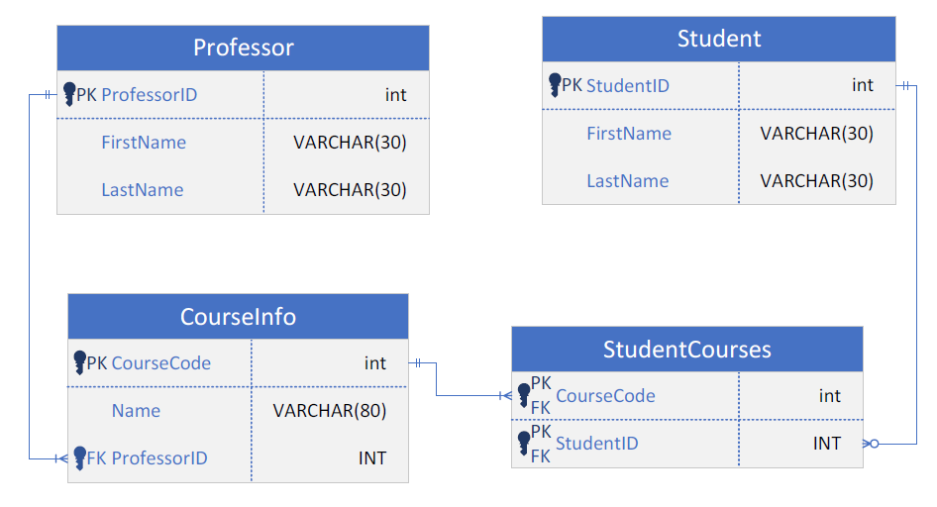
Entity Relationship Diagram (ERD)

Slide 8
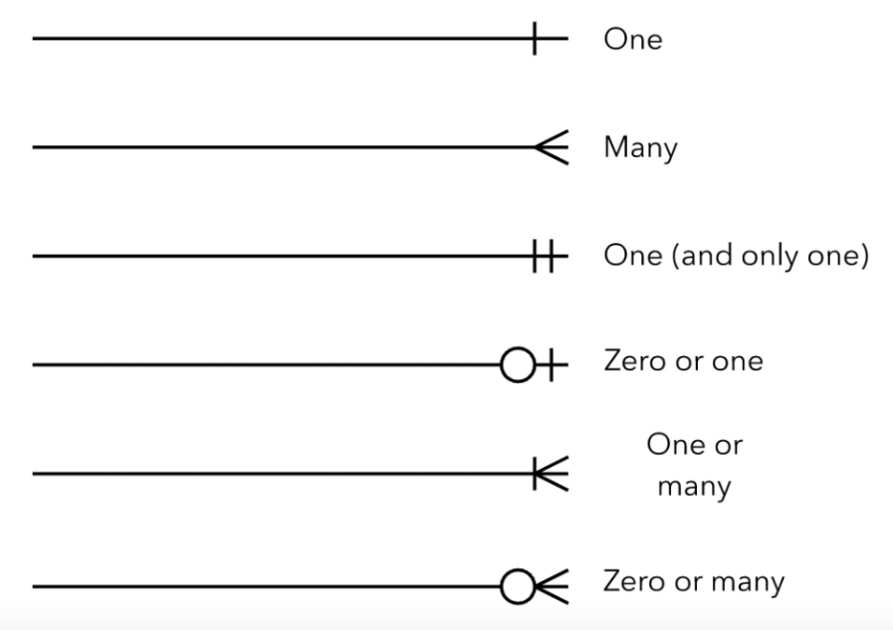
ERD Cardinality (Crow’s Foot Notation)

Slide 9
What is Normalization?
Normalization is rules for designing a database to reduce data redundancy and improve data integrity
There are 5 normal forms. Getting a database to 3rd normal form is sufficient, 4th and 5th normal form are overkill
Normalization Rules:
Eliminates redundant data
Reduces modification anomalies
Insert anomalies
Deletion anomalies
Update anomalies
Ensures dependencies are logical

Slide 10
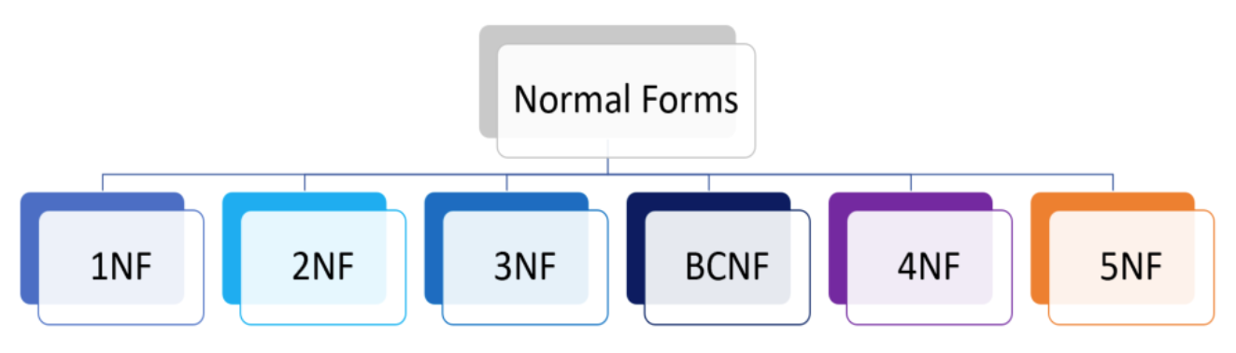
Why Normalize Data?
It is essential when dealing with large amounts of data
It allows us to organize data so it is free from redundancy, minimize data modification errors, and simplify query building
It can improve workflow, increase security, and decrease costs

Slide 11
Advantages of Data Normalization
Improved Data Organization – The database will be structured in a logical way
Data Consistency – Normalization ensures data consistency across all tables, improving workflow
Reduces Redundancy – Helps with database speed, reduces storage, and increases data processing time
Cost Reduction – the above benefits help to reduce the costs of the database.
Increased Security – Normalization requires that data is more accurately located and better organized, thus security is increased

Slide 12
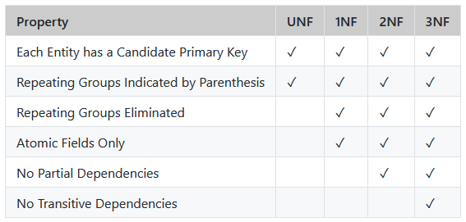
Normal Forms

Slide 13
UNF
Unnormalized data is also known as UNF or 0NF, sometimes also referred to as an unnormalized relation or non-first normal form
UNF Steps:
Step 1: Choose the entity (name) and list the attributes
Step 2: Eliminate calculated fields and add fields not there but we know we need them
Step 3: Identify the candidate key
Step 4: identify repeating groups
TA-DA! Now your entity is in UNF

Slide 14
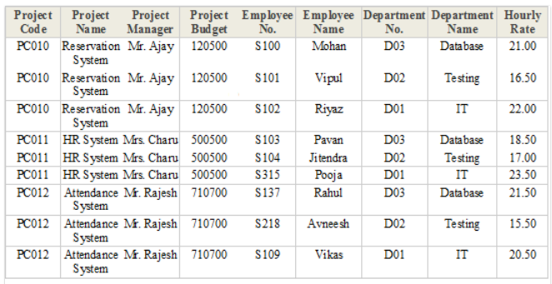
UNF

Slide 15
UNF
Step 1: Choose the entity (name) and list the attributes
EMP_PROJECT [ProjectCode, ProjectName, ProjectManager, ProjectBudget, EmployeeNo, EmployeeName, DepartmentNo, DepartmentName, HourlyRate]
Step 2: Eliminate calculated fields and add fields not there but we know we need them
EMP_PROJECT [ProjectCode, ProjectName, ProjectManager, ProjectBudget, EmployeeNo, EmployeeName, DepartmentNo, DepartmentName, HourlyRate]
Step 3: Identify the candidate key
EMP_PROJECT [ProjectCode, ProjectName, ProjectManager, ProjectBudget, EmployeeNo, EmployeeName, DepartmentNo, DepartmentName, HourlyRate]
Step 4: identify repeating groups
EMP_PROJECT [ProjectCode, ProjectName, ProjectManager, ProjectBudget, (EmployeeNo, EmployeeName, DepartmentNo, DepartmentName, HourlyRate)]
Final UNF
EMP_PROJECT [ProjectCode, ProjectName, ProjectManager, ProjectBudget, (EmployeeNo, EmployeeName, DepartmentNo, DepartmentName, HourlyRate)]

Slide 16
1NF
A database table is said to be in 1NF if it contains no repeating fields/columns. The process of converting the UNF table into 1NF is as follows:
Must already be in UNF
Separate the repeating fields into new database tables along with the key from the unnormalized database table.
The primary key of new database tables may be the composite key.

Slide 17
1NF
Step 1: Already in UNF
EMP_PROJECT [ProjectCode, ProjectName, ProjectManager, ProjectBudget, (EmployeeNo, EmployeeName, DepartmentNo, DepartmentName, HourlyRate)]
Step 2: separate repeating groups while maintaining relationships
PROJECT [ProjectCode, ProjectName, ProjectManager, ProjectBudget]
EMPLOYEE [FK ProjectCode, EmployeeNo, EmployeeName, DepartmentNo, DepartmentName, HourlyRate]
Step 3: identify non-atomic fields
PROJECT [ProjectCode, ProjectName, ProjectManager, ProjectBudget]
EMPLOYEE [FK ProjectCode, EmployeeNo, EmployeeFName, EmployeeLName, DepartmentNo, DepartmentName, HourlyRate]
Final 1NF:
PROJECT [ProjectCode, ProjectName, ProjectManager, ProjectBudget]
EMPLOYEE [FK ProjectCode, EmployeeNo, EmployeeFName, EmployeeLName, DepartmentNo, DepartmentName, HourlyRate]

Slide 18
2NF
2NF Rules:
Must be in 1NF
Has no partial dependencies. (All non-key attributes are fully dependent on a primary key)
CourseName → StudentID (since CourseName depends on part of the primary key, which is StudentID)

Slide 19
2NF
Step 1: Must in 1NF
PROJECT [ProjectCode, ProjectName, ProjectManager, ProjectBudget]
EMPLOYEE [FK ProjectCode, EmployeeNo, EmployeeFName, EmployeeLName, DepartmentNo, DepartmentName, HourlyRate]
Step 2: Identify Partial & Fix Dependencies
PROJECT [ProjectCode, ProjectName, ProjectManager, ProjectBudget]
EMP_PROJECT [FK ProjectCode, FK EmployeNo, HourlyRate]
EMPLOYEE [EmployeeNo, EmployeeFName, EmployeeLName, DepartmentNo, DepartmentName]
Final 2NF:
PROJECT [ProjectCode, ProjectName, ProjectManager, ProjectBudget]
EMP_PROJECT [FK ProjectCode, FK EmployeNo, HourlyRate]
EMPLOYEE [EmployeeNo, EmployeeFName, EmployeeLName, DepartmentNo, DepartmentName]

Slide 20
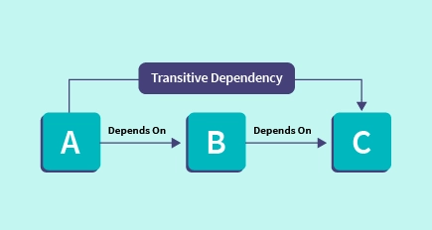
3NF
Transitive Dependency - is an indirect dependency relationship between software components. This kind of dependency is held by virtue of a transitive relation from a component that the software depends on directly
3NF Rules:
Must be in 2NF
Has no transitive dependencies.

Slide 21
3NF
Step 1: Must in 2NF
PROJECT [ProjectCode, ProjectName, ProjectManager, ProjectBudget]
EMP_PROJECT [FK ProjectCode, FK EmployeNo, HourlyRate]
EMPLOYEE [EmployeeNo, EmployeeFName, EmployeeLName, DepartmentNo, DepartmentName]
Step 2: Identify and Fix Transitive Dependencies
PROJECT [ProjectCode, ProjectName, ProjectManager, ProjectBudget]
EMP_PROJECT [FK ProjectCode, FK EmployeNo, HourlyRate]
EMPLOYEE [EmployeeNo, EmployeeFName, EmployeeLName, FK DepartmentNo]
DEPARTMENT [DepartmentNo, DepartmentName]
Final 3NF:
PROJECT [ProjectCode, ProjectName, ProjectManager, ProjectBudget]
EMP_PROJECT [FK ProjectCode, FK EmployeNo, HourlyRate]
EMPLOYEE [EmployeeNo, EmployeeFName, EmployeeLName, FK DepartmentNo, DepartmentName]

Slide 22

Summary
Subqueries
Examples of
Table (multiple rows and columns)
List
scalar

